Slide 1

ONLINE COURSE RESERVATION SYSTEM
KUBERAN V
422519205021
B.Tech (Information technology)
Anna university villupuram.

Slide 2
INTRODUCTION
course reservation system is an interface between the student and the registrar responsible for the issue of course. It aims at improving the efficiency in the issue of course and reduces the complexities involved in it to the maximum possible extent.

Slide 3
Purpose
If the entire process of ‘issue of course’ is done in a manual manner them it would takes several months for the course to reach the applicant. Considering the fact that the number of applicants for courses is increasing every year, an automated system becomes essential to meet the demand. So this system uses several programming and database techniques to elucidate the work involved in this process.

Slide 4
OUTLINE
First meeting with Customer and Devoloper
Customer Requirements
Feasibility Analysis
Take dicision whether we will take the job or not.
Soft Team
Required Resources
User Interface
Use a process Model
System Design

Slide 5
PRFORMANCE REQUIRED
Each “click” should respond in no more than 3 seconds
Longer search functions should not take more than 10 seconds
Reasonable uptime is required.
Quick recovery if system is ever down

Slide 6
SOFTWARE REQUIREMENTS
_{XAMPP server (web server)}
_{HTMLl – frontend}
_{CSS – frontend}
_{PHP – backend}
_{JAVASCRIPT – backend}
_{Mysql}

Slide 7
HARDWARE REQUIREMENTS
1 GHz or high processor
516 MB or higher RAM
40 MB HDD space
printer

Slide 8
After analysis the requirements we need to create the following we pages
Home page
Login page
My page
Registration page
change password
edit profile
contact us

Slide 9
Features of admin
secure login
manage session
manage course
manage register student
list of enroll history
list of student logs

Slide 10
Features of students
secure login
list of courses available
list of faculty details
register for the course

Slide 11
ADVANTAGES
SAVE YOUR TIME AND MONEY
Best online guidance
Instant doubt resolution
Escape the traffic
Networking opportunities

Slide 12
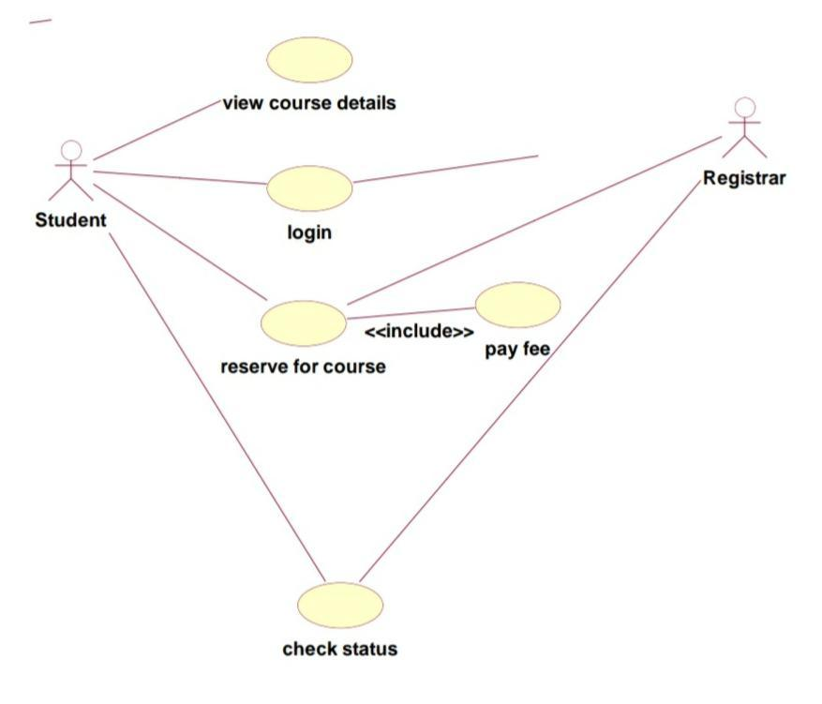
USE CASE DIAGRAM

Slide 13
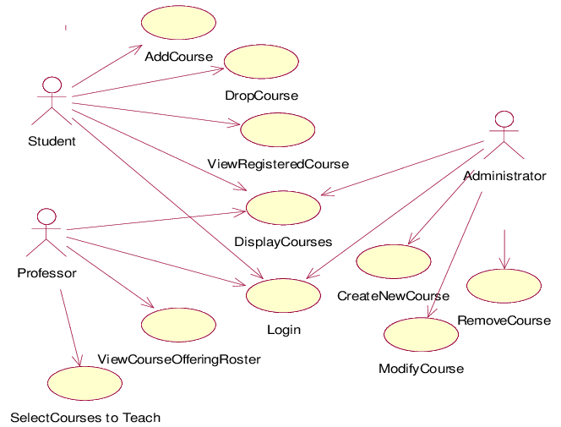
Detailed use case diagram

Slide 14
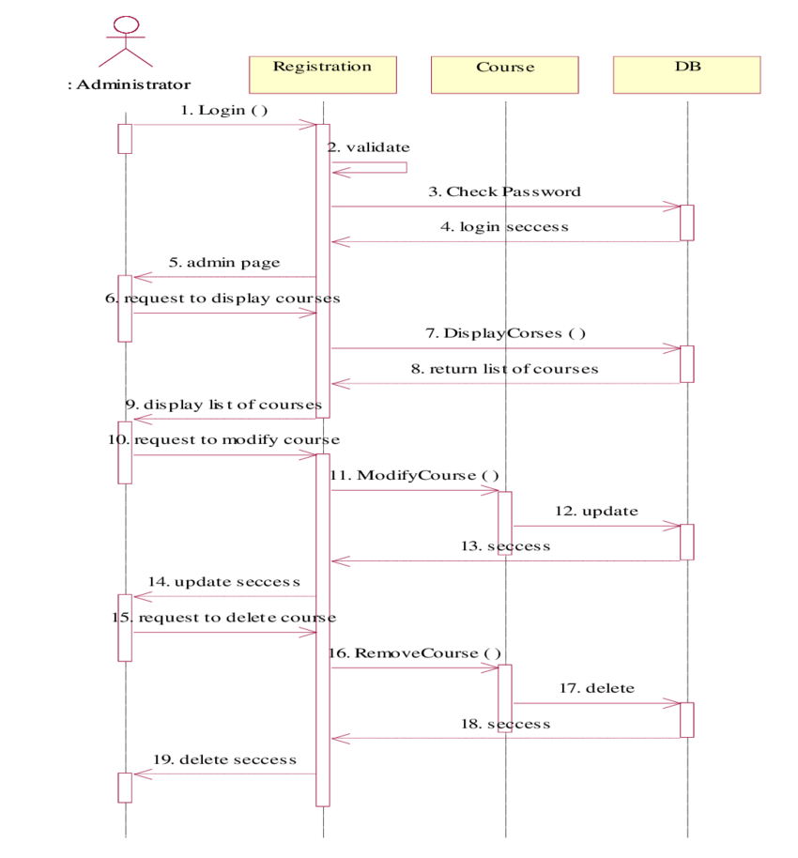
Sequence Diagram

Slide 15
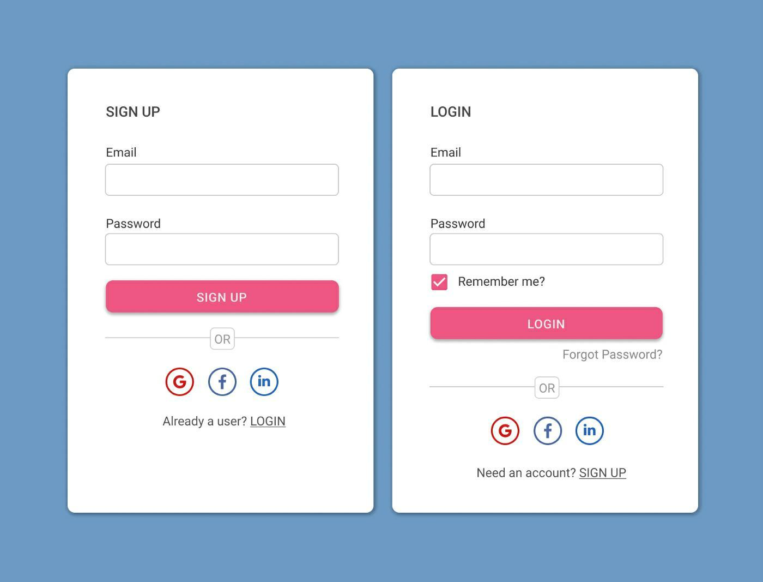
Index.html

Slide 16
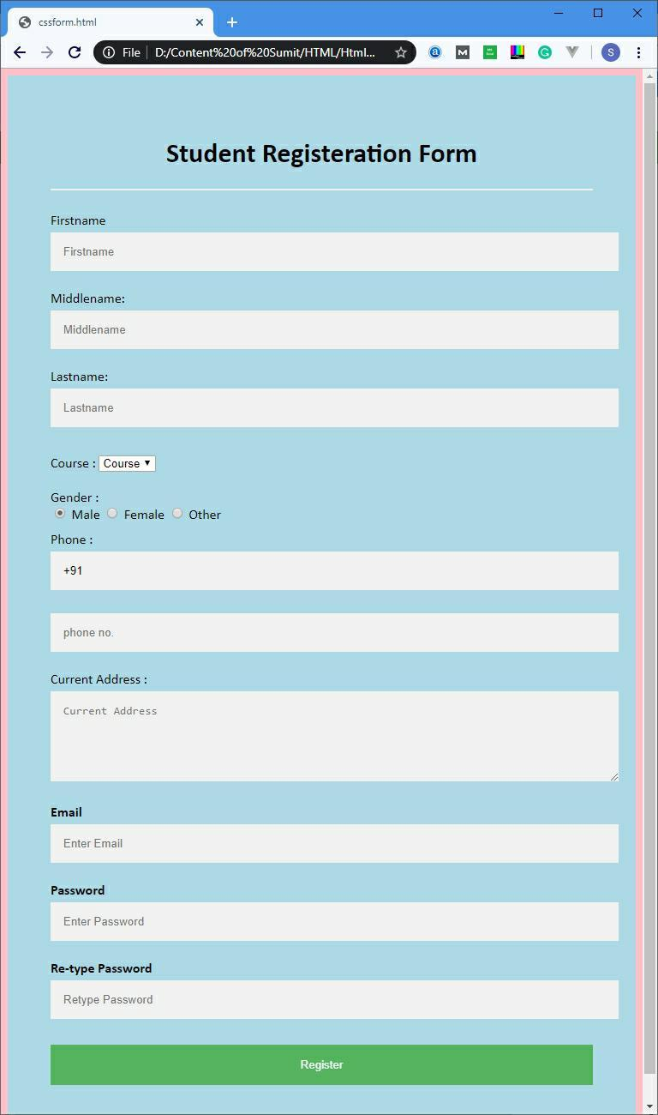
Registration.html

Slide 17

Submit.html

Slide 18
Project Scope
The system provides an online interface to the user where they can fill in their personal details and submit the necssary documents .
The registration system concerned with the issue of course can use this system to reduce his workload and process the application in a speedy manner.
Provide a communication platform between the student and the registrar.

Slide 19
CONCLUSION
By using online course reservation system application, a student can register for a course by providing valid credentials. Once login successful, student can view the available courses and register for selected course. This application provides automated system between student and registrar.

Slide 20

-KUBERAN

